Slide 1
IMAGE: Accessible Internet Graphics via Audio and Touch
Shared Reality Lab, McGill University
Gateway Navigation CCC Ltd. / Canadian Council of the Blind
https://image.a11y.mcgill.ca

Slide 2
IMAGE project introduction Internet Multimodal Access to Graphical Exploration
David Brun, Director/Founder, Gateway Navigation, CCC Ltd.
https://gnc3.com/go-image
Project genesis and background

Slide 3
IMAGE team at McGill University
Jeff Blum: technical project manager
Cyan Kuo: usability & UX lead
Dr. Yongjae Yoo: haptics lead
Prof. Jeremy Cooperstock: Director, Shared Reality Lab
16 additional team members not at conference

Slide 4
What is IMAGE?
Zero cost Chrome browser extension
Goal: Novel audio and touch (haptic) experiences of graphical content on the web:
Photos
Charts
Maps
Public beta released last week

Slide 5
So much technology…
You may already use:
Screen reader
Alt-text: manually entered
Alt-text: automatically generated
JAWS Picture Smart
VoiceOver image descriptions
Mostly text-based
Largely focus on the content of graphics, not the feel
IMAGE does not replace these tools
Not an overlay to correct website accessibility issues

Slide 6
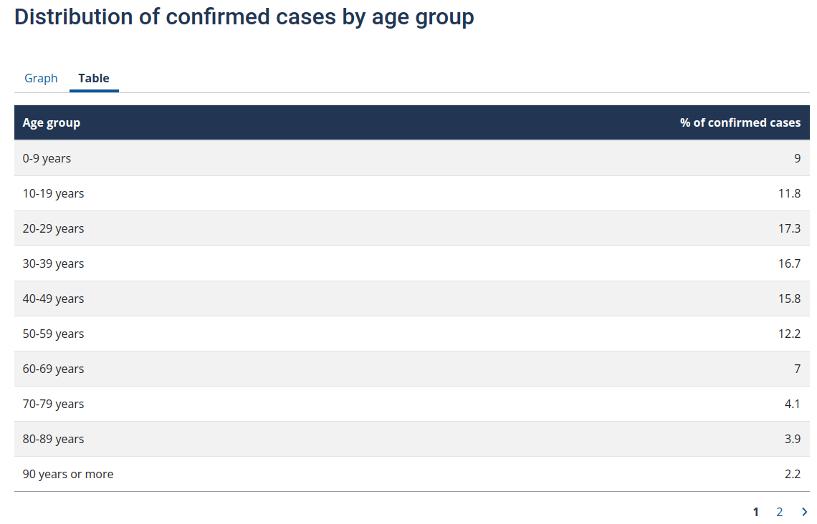
https://www.quebec.ca/en/health/health-issues/a-z/2019-coronavirus/situation-coronavirus-in-quebec

Slide 7
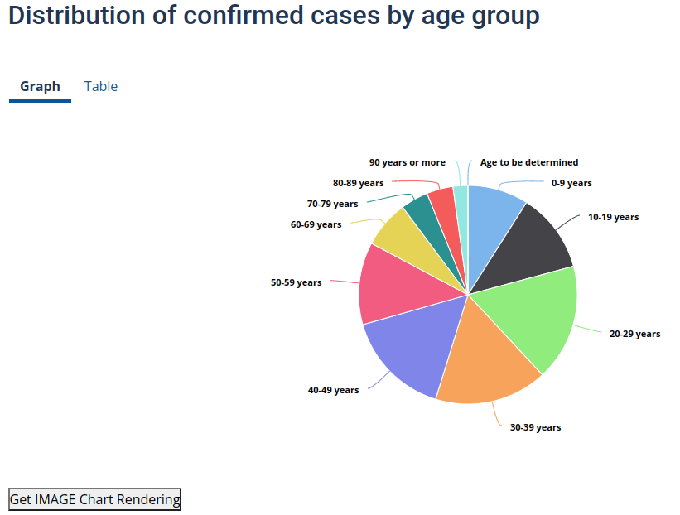
IMAGE representation
https://www.quebec.ca/en/health/health-issues/a-z/2019-coronavirus/situation-coronavirus-in-quebec

Slide 8
Audio + haptics (touch)
Audio is spatialized: rich and concise
Touch can add even more
Haptic devices are completely optional

Slide 9
Demonstration
Installation
Audio interpretations
Audio + Experimental touch interpretations:
Haply & Dot Pad

Slide 10
Website creators: photos
Make sure photo can be selected and supports the browser’s standard context menu functionality. Beware:
Carousels
Copy-protection schemes
Montages
Don’t forget alt-tags are still crucial for context!

Slide 11
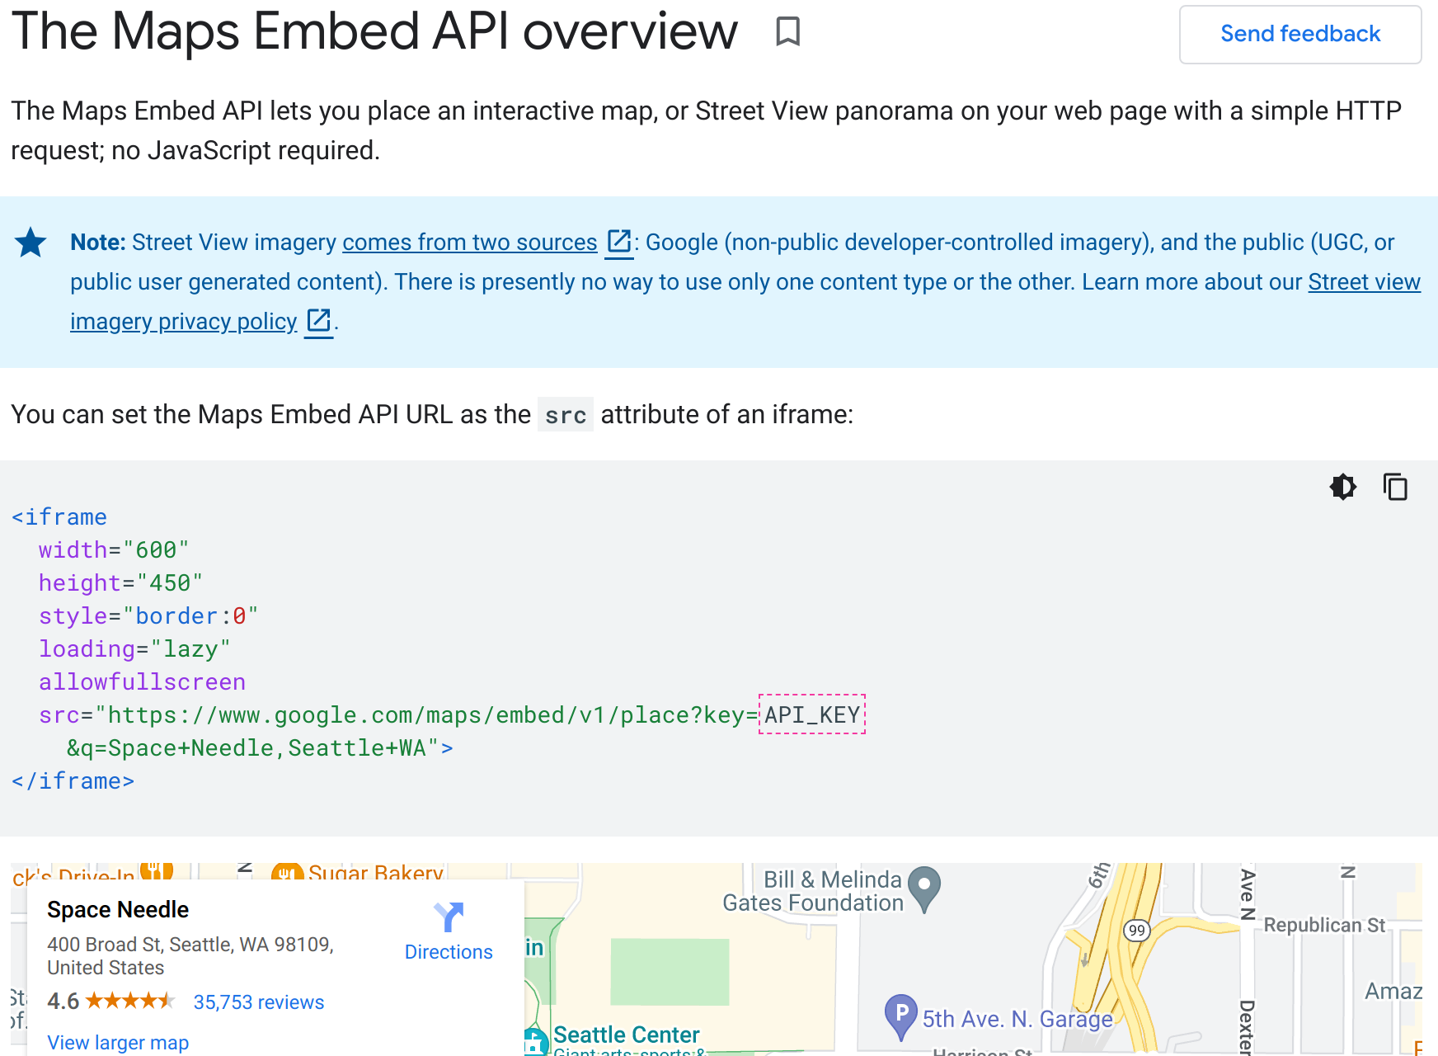
Website creators: maps
Embed Google maps in standard <iframe>:
https://developers.google.com/maps/documentation/embed/get-started

Slide 12
Website creators: charts
Use Highcharts format: https://www.highcharts.com/
Make sure to fill in Title and Subtitle fields!
Initial experiences for:
Line/Area charts (single trend line)
Pie charts
Future: Chart variations (line chart with 10 data points or a million data points need to be treated very differently!) More formats. Automatic data extraction?

Slide 13
Open source and extensible
https://github.com/Shared-Reality-Lab/IMAGE-browser https://github.com/Shared-Reality-Lab/IMAGE-server
Create & deploy new modules for IMAGE:
New machine learning tools
New audio/haptic experiences

Slide 14
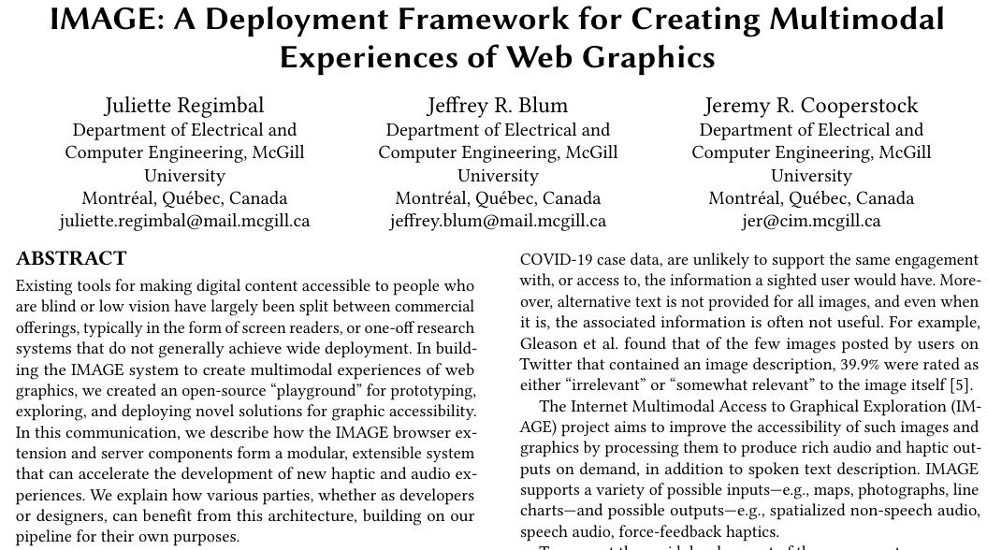
Developers: Extending IMAGE
IN PRESS: Juliette Regimbal, Jeffrey R. Blum, and Jeremy R. Cooperstock. 2022. IMAGE: A Deployment Framework for Creating Multimodal Experiences of Web Graphics. In 19th Web for All Conference (W4A’22), April 25–26, 2022, Lyon, France. ACM, New York, NY, USA

Slide 15
The future of IMAGE
Deep need: excitement from participants trying what’s next
Participant testimonial
We’re particularly excited about:
Fully integrating haptic devices
Mobile: iPhone, Android
Taking advantage of improved machine learning tools

Slide 16
Acknowledgements
McGill IMAGE team: Aidan Williams, Ben Macnaughton, Clarisa Gapare, Cyan Kuo, Florian Grond, Gandharv Patil, Hongye Chen, Jaydeep Singh, Jeffrey Blum, Jeremy Cooperstock, John Sullivan, Juliette Regimbal, Rakshitha Ravi, Rayan Isran, Rohan Akut, Sabrina Knappe, Samuel John, Siddharth Rao, Sri Gannavarapu, Yongjae Yoo
Gateway Navigation CCC Ltd.
Canadian Council of the Blind (CCB)
Innovation, Science and Economic Development Canada (ISED)

Slide 17
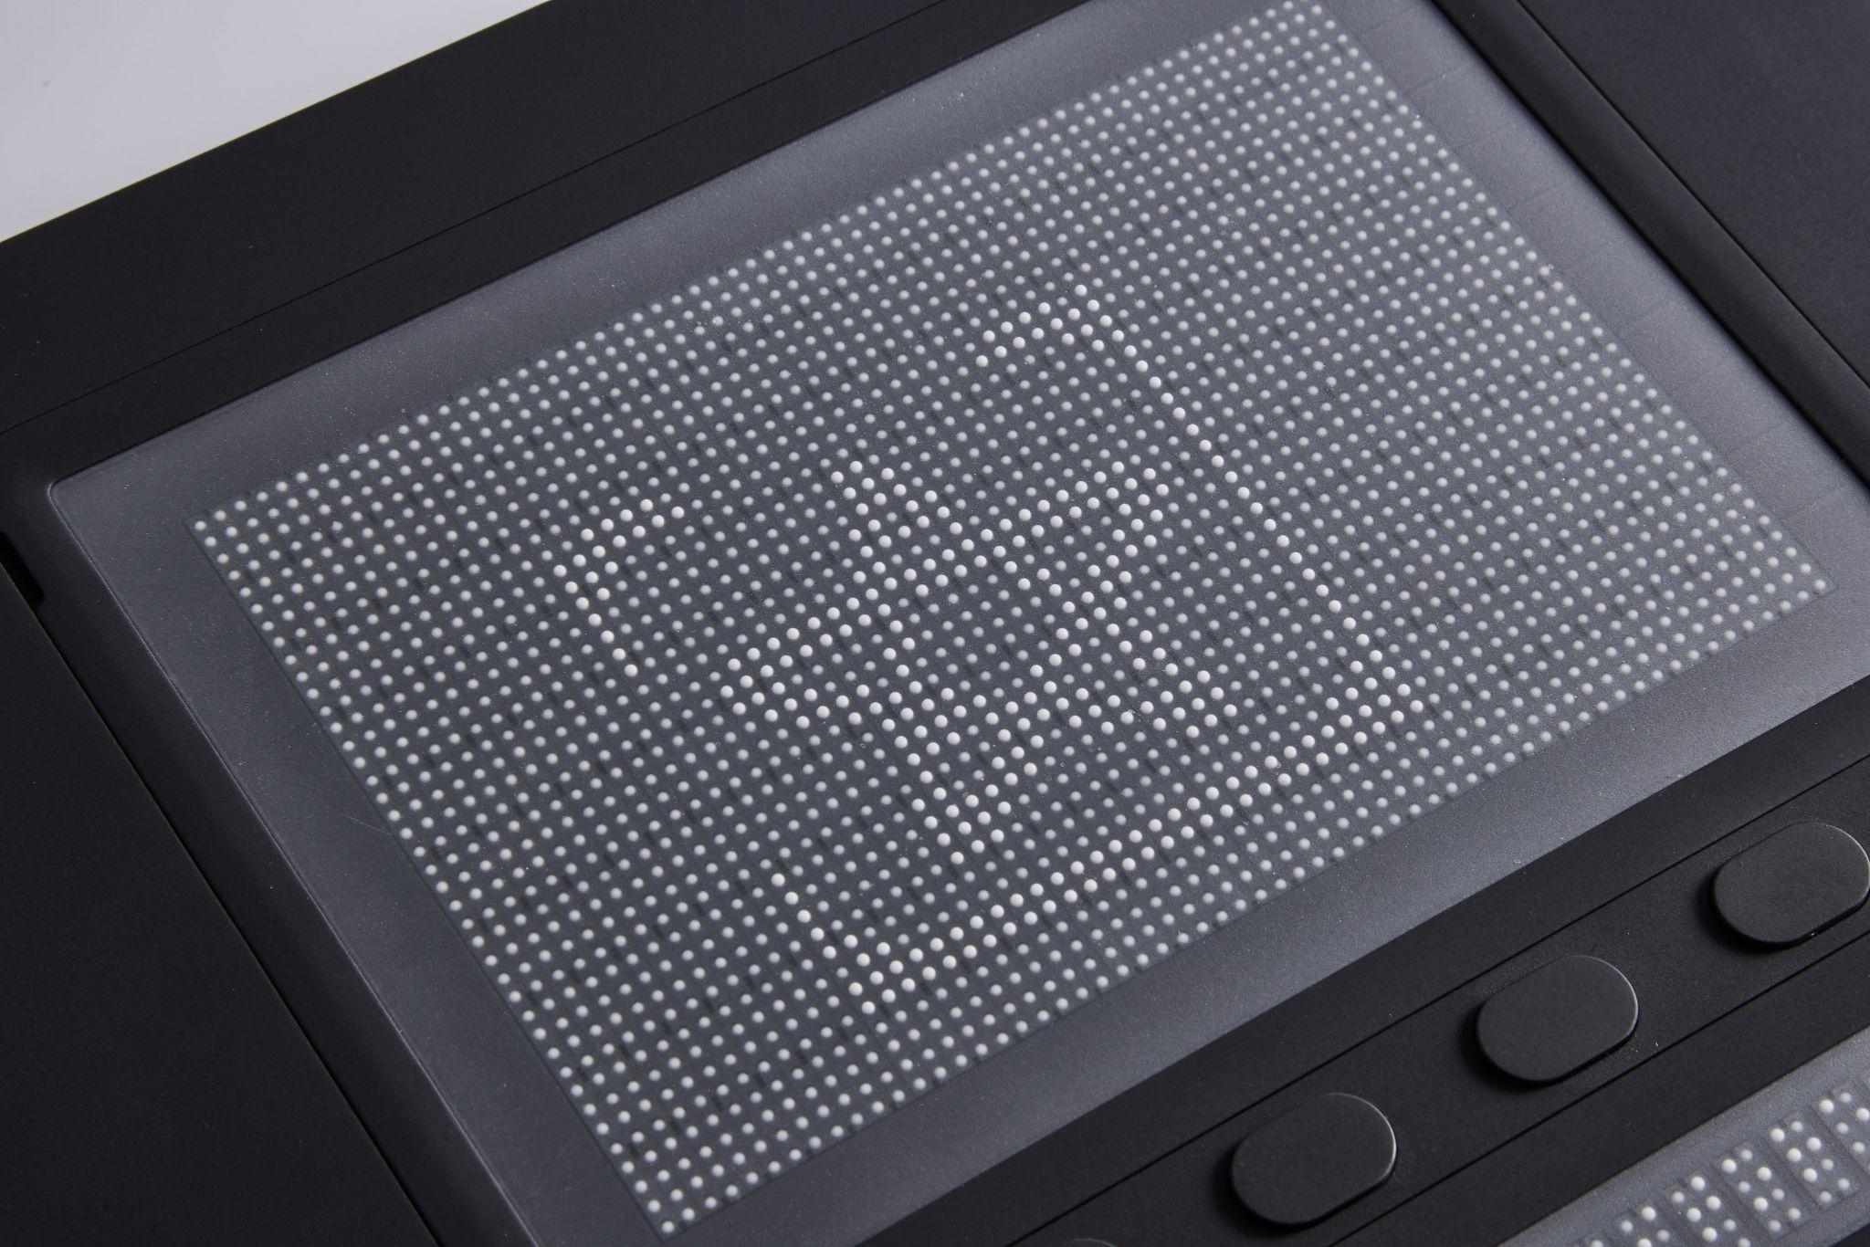
Visit us in Dot’s booth #612
IMAGE team:
Today until 5pm
Friday 9:30am-12pm
Try the Dot Pad yourself in the Dot booth anytime!
Don’t miss Dot’s presentation:
The Dot Pad: The Full Screen Tactile Display for the Blind
Friday at 4pm, Grand ABCD

Slide 18
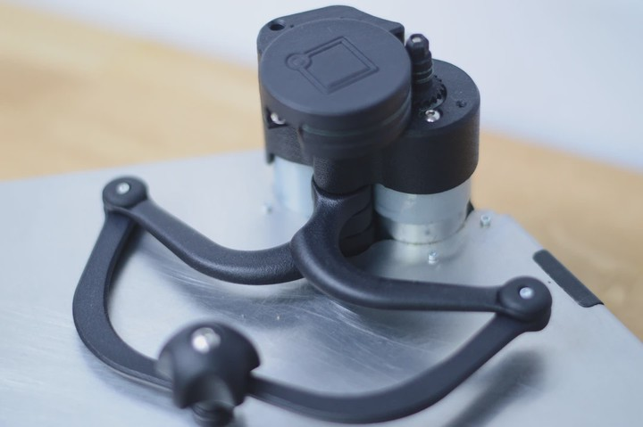
Visit us here at the conference
To learn more about IMAGE or give feedback in person:
Marriott Oasis Tower Room 1453 Wednesday 11am-1pm Thursday 2pm-4pm
We also have a Haply 2diy you can test out!

Slide 19
Find us online
https://image.a11y.mcgill.ca https://gnc3.com/go-image
image@cim.mcgill.ca
To participate in ongoing research, complete the survey found on our website and provide your contact information.
We look forward to building IMAGE together with you!

